Slide 1

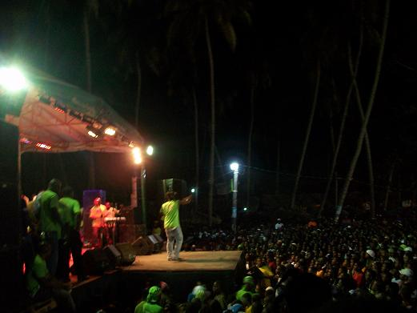

HAITIAN TUBES POPULARITY
Analysis and Prediction
Ayiti-Analytics bootcamp final project
By Leon Lovensky

Slide 2
BACKROUND …
Many concerned stakeholder
Music is integral part of our life
Important
Part of the country economy

Slide 3




Concerned Stakeholder
Music distributors
Venues Owner
Artists
Producers

Slide 4

Hypothesis and desired Outcomes
Understand which feature of a song are important to predict the song popularity
Using song features, build a model whiich can predict if a given song will be above or below the mean of song popularity scores of the data

Slide 5


Data
Youtube Data Api
90 Channels exported
Instagram Api

Slide 6
Data processing
Download the Api data in many json file and then convert them in dataframe stored in CSV file
Extract all the statistics data regarding each song on youtube, using python, such as, Duration, publication age, like, dislikes, views and comments count.
Download related main and featuring artist features from Instagram data API, such as, number of followers

Slide 7
Data exploration
Traditional Data Cleansing, such as, remove NANs, or song missing statistics features or sont with a duration bigger than 5mn 30 or lesser than 3 mn
Change duration column format from string to secondes
Separate name from title, and artist from artist features.

Slide 8
Data processing
After data cleansing, left with ………. Rows and 8 important features for the case study
Evaluate features relevance, using correlation matrice

Slide 9
Data Exploration
Data Trends over the year.- fig1

Slide 10
Data Exploration
Numbers of song over the years.- fig 2

Slide 11
Data Exploration
Most popular song sorted by contents_Views and year.- fig 3

Slide 12
Data Exploration
Statistics

Slide 13
Data Exploration
Features importance.-
Using Random forest

Slide 14
Result
Model evaluation

Slide 15
Conclusion
Model evaluation

